Slide 1
Web App Development 1.2
JavaScript 1

Slide 2
Semester 2 – JavaScript
JavaScript
DOM Scripting
References:
W3 Schools website tutorial
https://www.w3schools.com/js/default.asp
W3 Reference
https://www.w3schools.com/jsref/default.asp
Murach’s Javascript and DOM scripting
https://www.murach.com/shop/murach-s-javascript-2nd-edition-detail

Slide 3
How a web server processes a static web page
Two protocols that web applications depend upon
Hypertext Transfer Protocol (HTTP)
Transmission Control Protocol/Internet Protocol ( TCP/IP).

Slide 4
How a web server processes a dynamic web page
Server-side scripting languages
ASP.NET
JSP
PHP
ColdFusion
Ruby
Perl
Python

Slide 5
How JavaScript fits into this architecture

Slide 6
Static v Dynamic Web Pages
HTML by itself is limited in what it offers Web surfers in terms of interactivity : a Web surfer can click on a link or fill in a form
JavaScript makes Web pages more dynamic by generating events that can result in many actions
JavaScript is a cross-platform, object-based scripting language
The two main reasons we use JavaScript in Web pages are dynamics and client-side execution
dynamics include intercepting and processing mouse clicks; opening popup windows when a Web page is loaded/unloaded, and animation
client-side execution includes validating form input

Slide 7
Common Uses for JavaScript
Validate form data before it is sent to the server for processing.
Respond to user actions such as mouse clicks and key presses.
Create dynamic menus.
Create slide shows.
Animate elements in a web page.
Create timers, clocks, and calendars.
Change the style sheet that a web page uses.
Sort the data that’s in a table.
Control the web browser window.
Detect web browser plug-ins.
Open new web browser windows.
Change images when the user rolls the mouse over an image.

Slide 8
What is JavaScript?
JavaScript is the world's most popular programming language. It is the language for HTML and the web, for servers, PCs, laptops, tablets, smart phones, and more.
JavaScript is a scripting language - a lightweight programming language.
JavaScript is programming code that can be inserted into HTML pages.
JavaScript inserted into HTML pages, can be executed by all modern web browsers.

Slide 9
JavaScript Introduction
Like HTML, JavaScript is interpreted (and not compiled, like Java)
interpreted: a JavaScript script is interpreted (executed) as and when you run the script
compiled: a Java program is compiled first and then you execute it
The browser has an interpreter that scans the JavaScript code and interprets it
All that is needed to execute JavaScript code is a Web browser; there is no need for compilers or runtime environments (as is the case with Java)

Slide 10
JavaScript Introduction
JavaScript was developed by Brandon Eich (Netscape) in 1995 and became successful because of its simplicity and power
Inspired by Java, Scheme and Self programming languages
It is universal and runs in any browser
Two types of JavaScript exist: client side and server side.
client side JavaScript is the code that is sent to the browser along with the HTML code of a Web page and is executed on the client by the browser
server side JavaScript stays on the server and can be executed only by the server; Web browsers cannot execute it
we are only interested in client side JavaScript

Slide 11
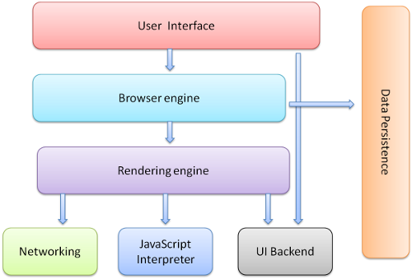
Browser Components

Slide 12
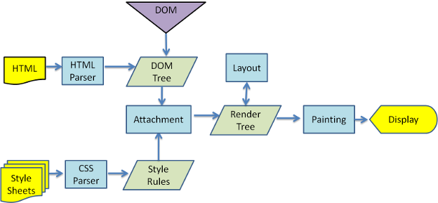
Browser – Loading a web page

Slide 13
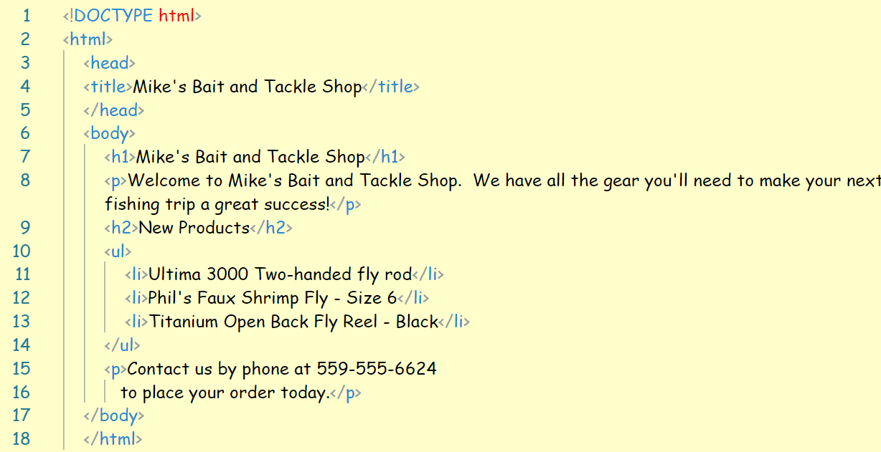
Document Object Model

Slide 15
An Introduction to the DOM
The document object model (DOM) is a collection of nodes in the web browser’s memory that represent the current webpage. The nodes are organised in a hierarchy.
The DOM is built when the page is loaded in the browser
JavaScript can modify the web page in the browser by modifying the DOM
When the DOM is changed, the browser immediately displays the change on the webpage
JavaScript applications usually manipulate the DOM based on user actions
Demo (Demo Calc) Available on Moodle

Slide 16
How Web Pages interact with DOM events

Slide 17
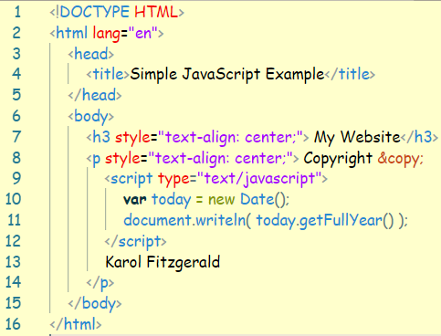
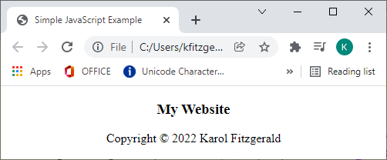
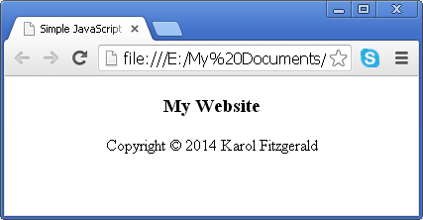
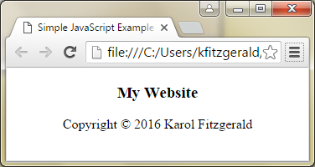
Introduction to JavaScript

Slide 18
Basic JavaScript
JavaScript is case-sensitive.
JavaScript statements end with a semicolon.
JavaScript ignores extra whitespace in statements.
Single-line comments begin with two forward slashes.
Multi-line comments begin with /* and end with */.

Slide 19
Inputs and Outputs
Establishing a line of communication

Slide 20
Window alert() Method
The alert() method displays an alert box with a specified message and an OK button.
An alert box is often used if you want to make sure information comes through to the user.
Note: The alert box takes the focus away from the current window, and forces the browser to read the message. Do not overuse this method, as it prevents the user from accessing other parts of the page until the box is closed.

Slide 21
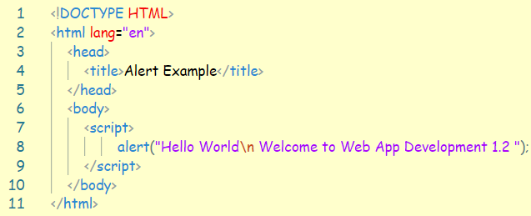
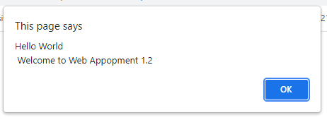
Window alert() Method
Recreate the following page and save it as AlertEx1.

Slide 22
Window prompt() Method
The prompt() method displays a dialog box that prompts the visitor for input.
A prompt box is often used if you want the user to input a value before entering a page.
Note: When a prompt box pops up, the user will have to click either "OK" or "Cancel" to proceed after entering an input value. Do not overuse this method, as it prevent the user from accessing other parts of the page until the box is closed.
The prompt() method returns the input value if the user clicks "OK". If the user clicks "cancel" the method returns null.

Slide 23
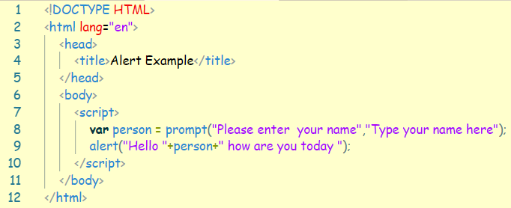
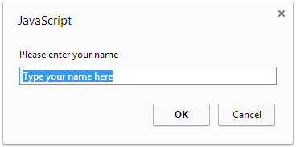
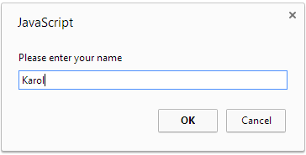
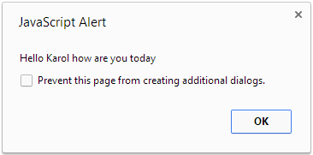
Window prompt() Method
Recreate the following page and save it as PromptEx1.

Slide 24
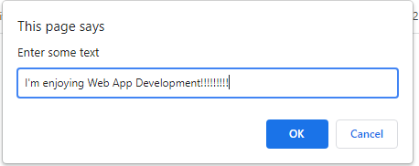
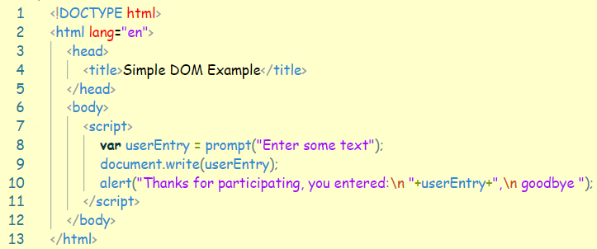
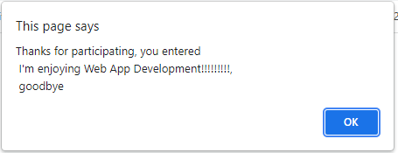
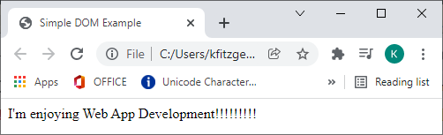
document.write() document.writeln()
We are updating the DOM
Recreate the following page and save it as AlertDOM.html

Slide 25
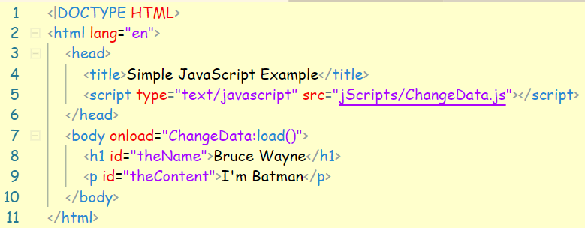
document.getElementById(“ID”).innerHTML
To access an HTML element, JavaScript can use the document.getElementById(id) method.
The ID attribute defines the HTML element. The innerHTML property defines the HTML content:
Recreate the following page and save it as DOM_ID.html

Slide 26
